Slide 1
Angular JS
And how you shouldn’t use it

Slide 2




Once in a blue moon…
One day our customer came to us and said that he really wants to hire 3 senior developer for at least a month.

Slide 3


And we hired 3 juniors…

Slide 4

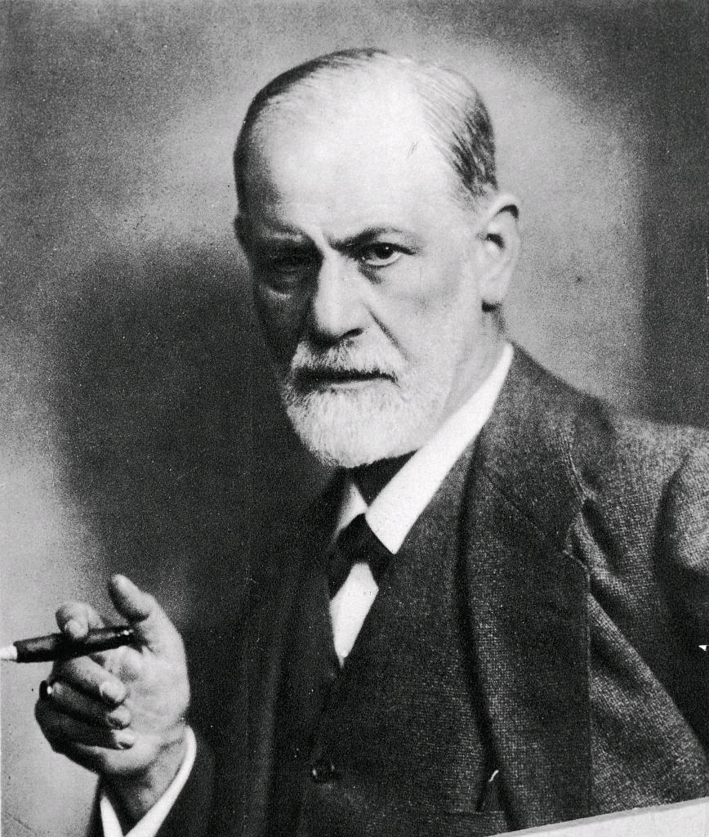
Scope Pollution

Slide 5
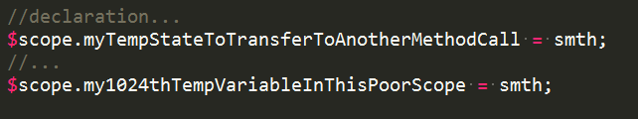
Scope Pollution
Don’t store all your temporary states, variables, parameters or anything else which is not supposed to be (spell-)bound.

Slide 6
Scope Pollution
You can create a service to share/store some states.
Or use OOP and store your temp variables, state inside your objects (e.g. Controller object).
Or use messaging.
Or anything else your creativity will invent.

Slide 7

Don’t take Angular JS as a dogma, or religion, or religious dogma

Slide 8
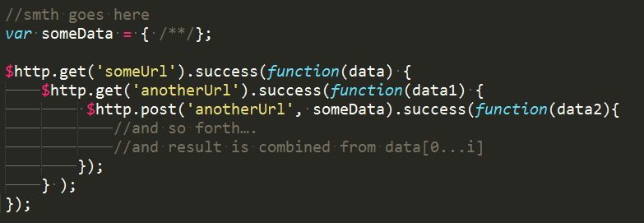
Don’t chain calls if they can be done simultaneously

Slide 9
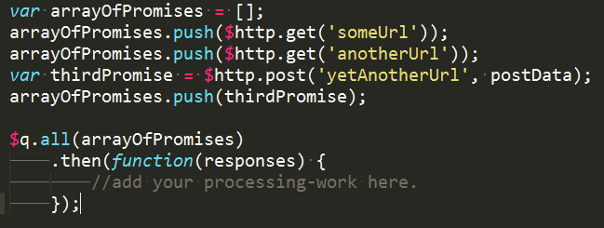
Just make them run simultaneously!

Slide 10
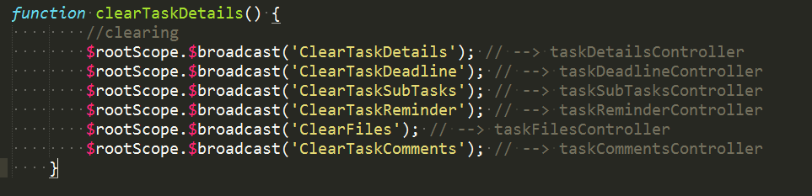
Don’t violate and misuse ng event model.
One should understand the event (messaging) model before using it.
It’s so easy – where can be any underwater stones? You’re welcome!

Slide 11
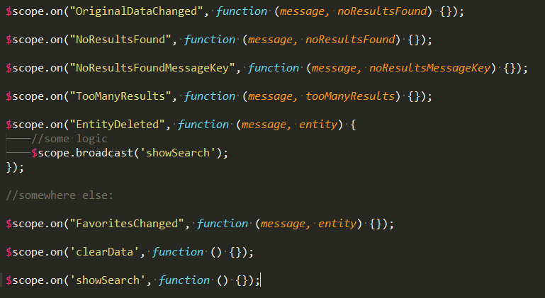
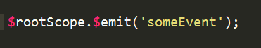
Once in a real life… or twice…

Slide 12

...and don’t take my words as a dogma or religion, or religious dogma

Slide 13
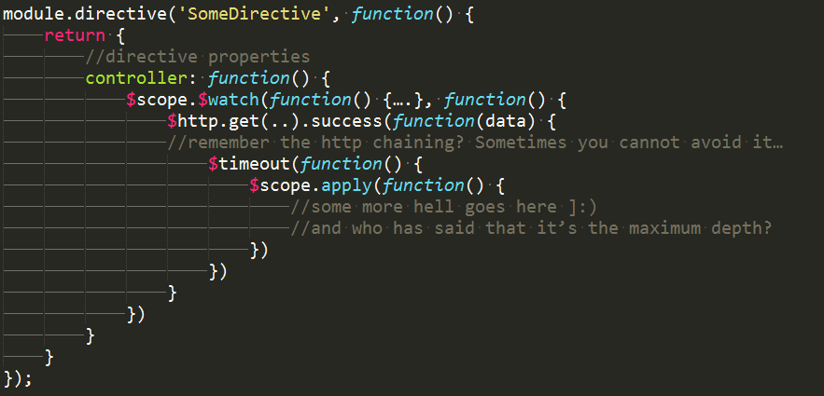
Spaghetti code

Slide 14
Nice code, I like it, WAT is wrong with it?
So this slide is not for you =)
Declare a directive-constructing function somewhere else if your directive is big enough.
Declare a controller-function not inside your directive function, if it’s big enough.
Declare http-result processing callback as a separate functions.
Extract any other big-enough callbacks in a separate functions.

Slide 15
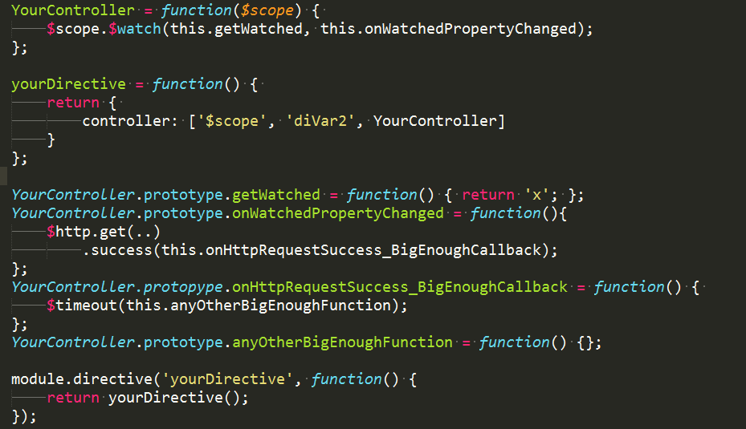

Slide 16
Spaghetti code

Slide 17
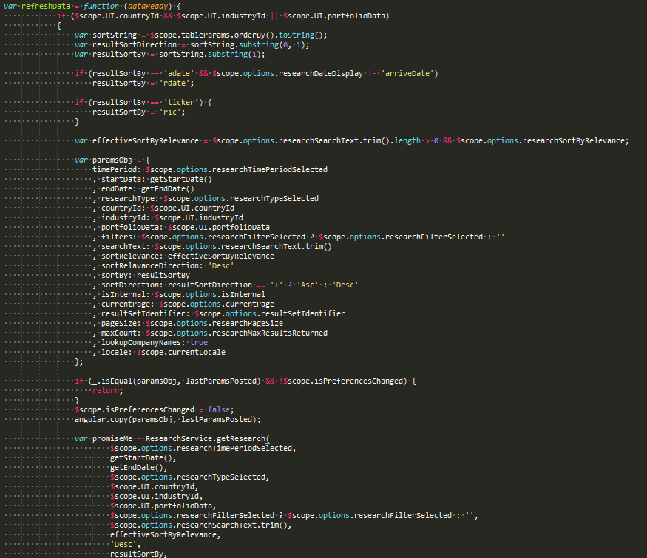
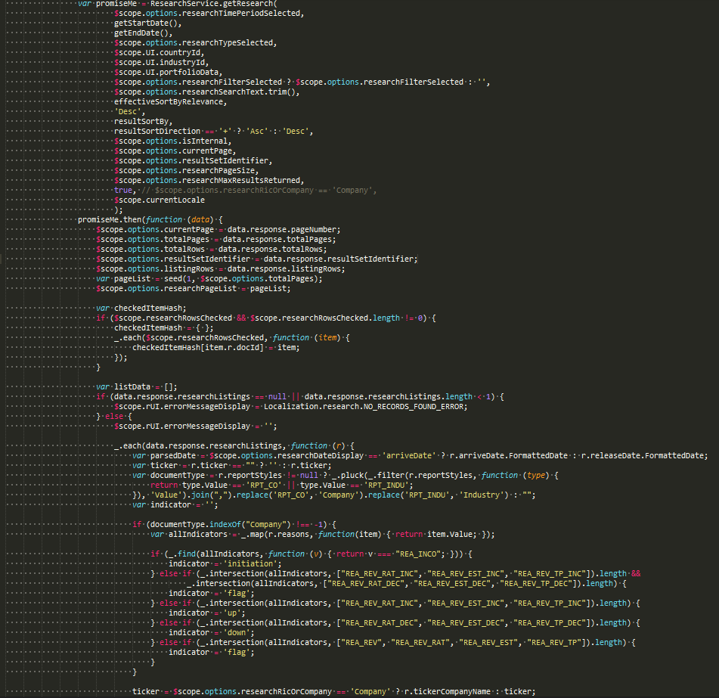
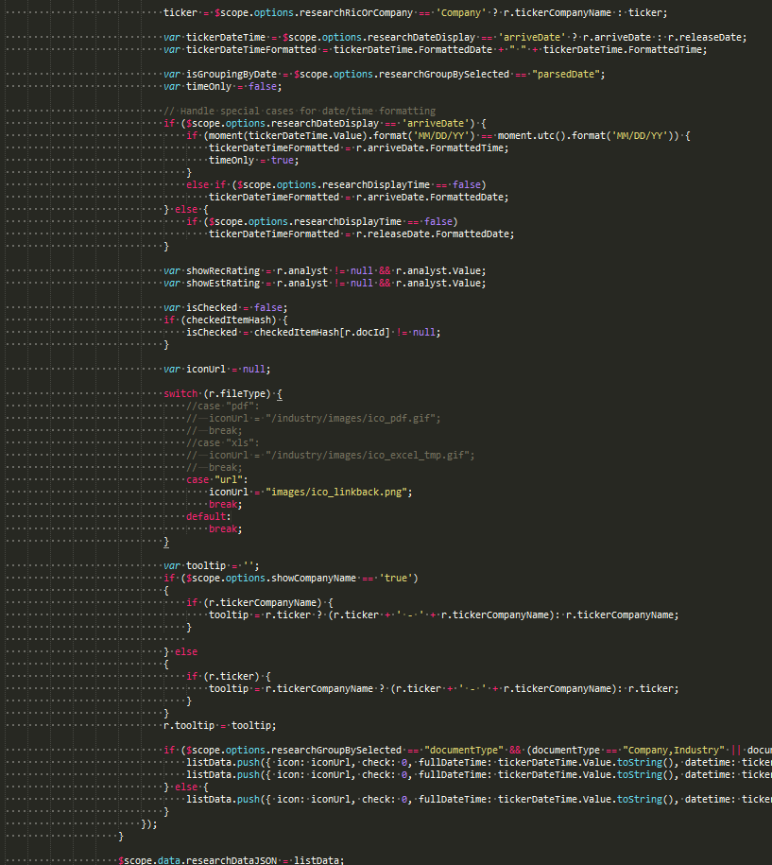
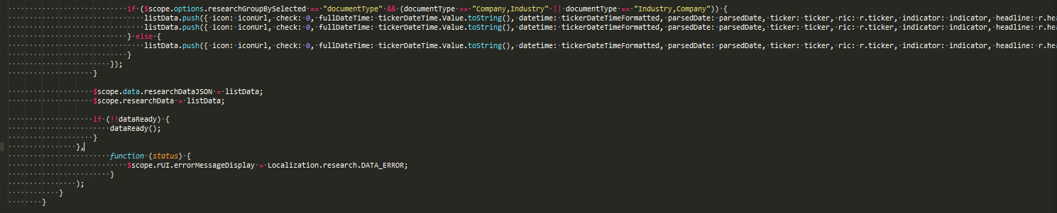

Slide 18
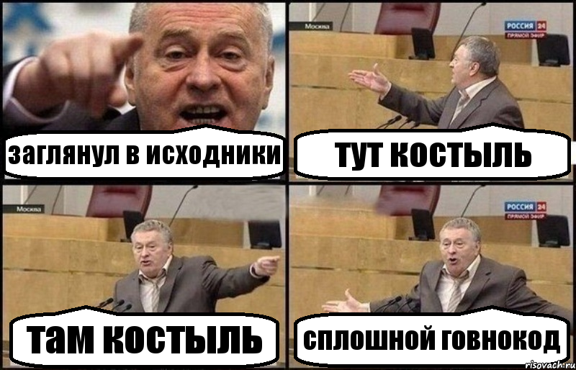

Slide 19
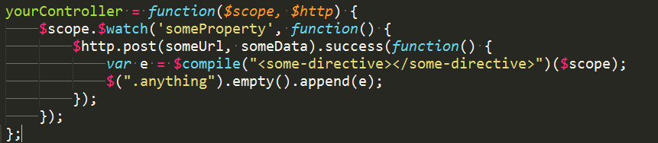
DOM manipulations, $compile in Controllers???
Just an ordinary controller – thousandzzz of them!
This sample wasn’t crawling out from darkest corners of my mind

Slide 20
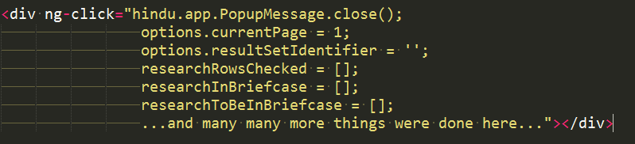
Is there any difference with this?

Slide 21

Alternative?
There is one: put your dom-manipulation logic inside directive as much it’s possible. Or continue doing whatever you did before =)

Slide 22

Separation of concerns.
Previous ‘practices’ are all closely tied with this principle. This principle is a root cause for all of them, as it seems to be in my opinion.

Slide 23
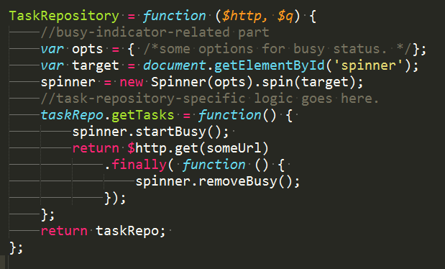

Service to retrieve backend data also takes responsibility to set the busy-status (manipulates DOM).

Slide 24
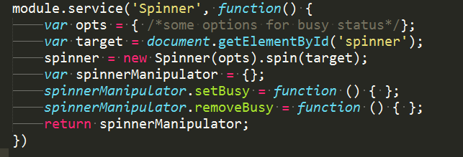
Separate concerns – single responsibility, etc.

Slide 25
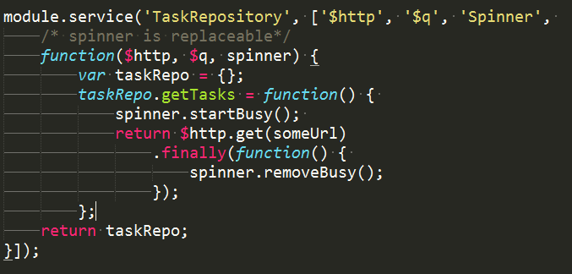
And your service would be testable – just inject mock spinner, or another spinner, or anything else

Slide 26

Ruthless and Senseless empty error callbacks.

Slide 27
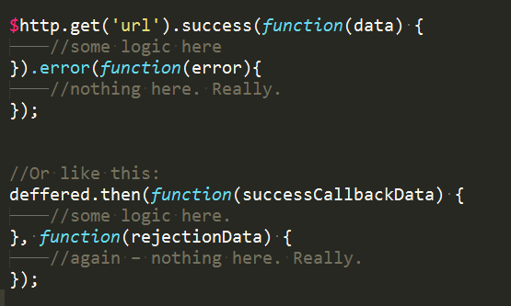
Sample?

Slide 28
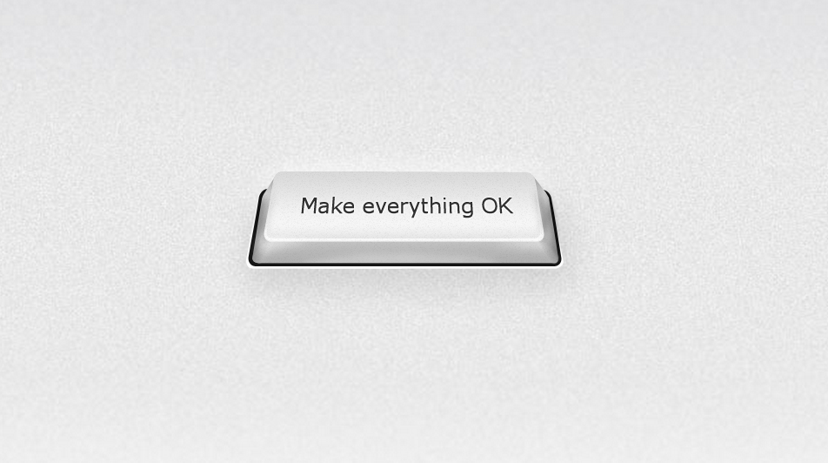

Slide 29
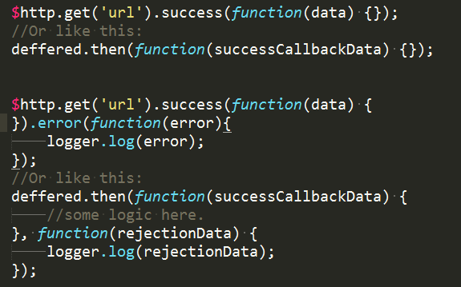

Slide 30
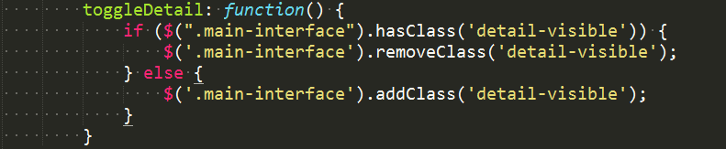
Usage of implicitly defined objects instead of theirs ng-wrappers.
window instead of $window
event instead of $event
setTimeout & $scope.apply instead of $timeout
setInterval & scope.apply instead of $interval
etc.

Slide 31

...or anything else as a dogma, or religion, or religious dogma

Slide 32


